Slide 1
METHODOLOGY
Overview of Approach
Introduces a novel hybrid binary optimization algorithm for feature selection.
Focused on identifying optimal feature subsets within a neural network architecture.
Methodology Breakdown
Stage 1: Design of the hybrid binary metaheuristic algorithm, including:
Mathematical modeling
Algorithmic representation
Stage 2: Integration of the optimizer into a neural network (NN):
Seamless embedding into the neural network structure
Evaluation of performance impact

Slide 2
METHODOLOGY
Base Algorithms – BEOSA, BPSO, and BDMO
Foundational Algorithm:
The core binary optimizer is BEOSA.
Aims to enhance exploration and exploitation capabilities leads to the hybridization with BPSO and BDMO
Hybridization Strategy:
BPSO and BDMO selected for their effective optimization dynamics.
These are integrated with BEOSA to create: HBEOSA-PSO, HBEOSA-DMO
Innovative Enhancements:
Introduction of Nested Transfer (NT) functions to improve binary search space handling. This leads to two additional variants: HBEOSA-PSO-NT , HBEOSA-DMO-NT

Slide 3
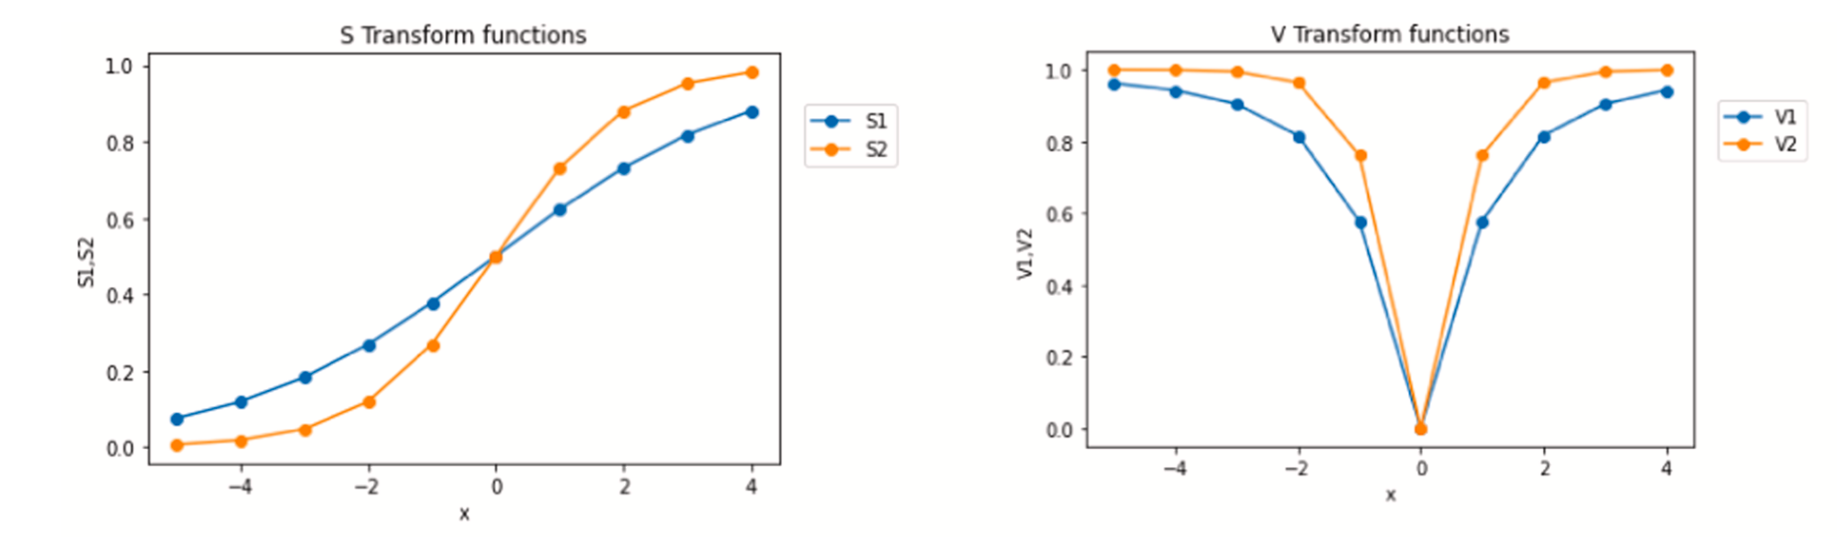
METHODOLOGY
Binary Ebola Optimization Search Algorithm (BEOSA)
Origin & Binarization
Derived from the continuous EOSA;
Biological Inspiration
Simulates Ebola infection dynamics:
Individuals in the search space represented as susceptible hosts.
Infection mimics mutation in feature representation, using fittest individual known, who infects the infected individual and some characteristics of Ebola diseases such as its circular nature, random nature etc.
Results in diverse subpopulations (e.g., infected, recovered,death,quarantine,rebirth).
Binarized using S-shaped and V-shaped transfer functions allows feature values to be transformed into binary form (0s and 1s) for optimization problems.

Slide 4
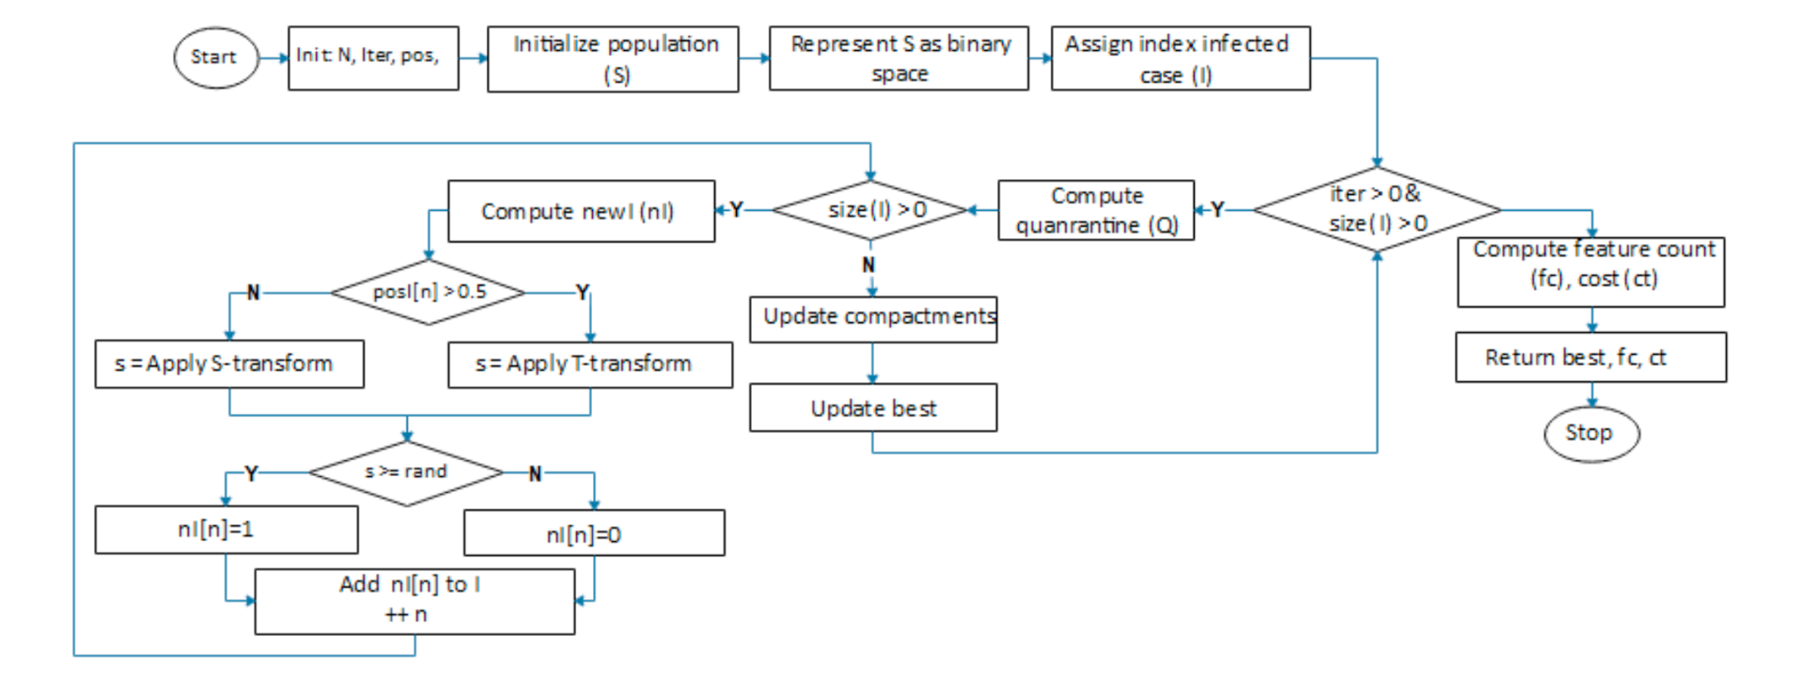
METHODOLOGY
Flow chart of BEOSA

Slide 5
METHODOLOGY
Hybridization Strategy – HBEOSA-PSO & HBEOSA-DMO
Integration Logic
Exploration phase:
When BEOSA attempts to explore new areas of the search space,
It delegates this to either BPSO or BDMO for wider population movement.
Exploitation phase:
When intensifying the search locally around promising candidates,
BPSO or BDMO is activated for refinement
And this is done after a carrier has infected its environment. Based on the assumption that infected individuals interact with each other either locally or move out of their locality
Resulting In Hybrid Algorithms
HBEOSA-PSO: BEOSA + BPSO collaboration → uses particle swarm behaviors to guide mutation and positioning.
HBEOSA-DMO: BEOSA + BDMO integration → uses mongoose-style spatial adaptation for mutation and local selection

Slide 6
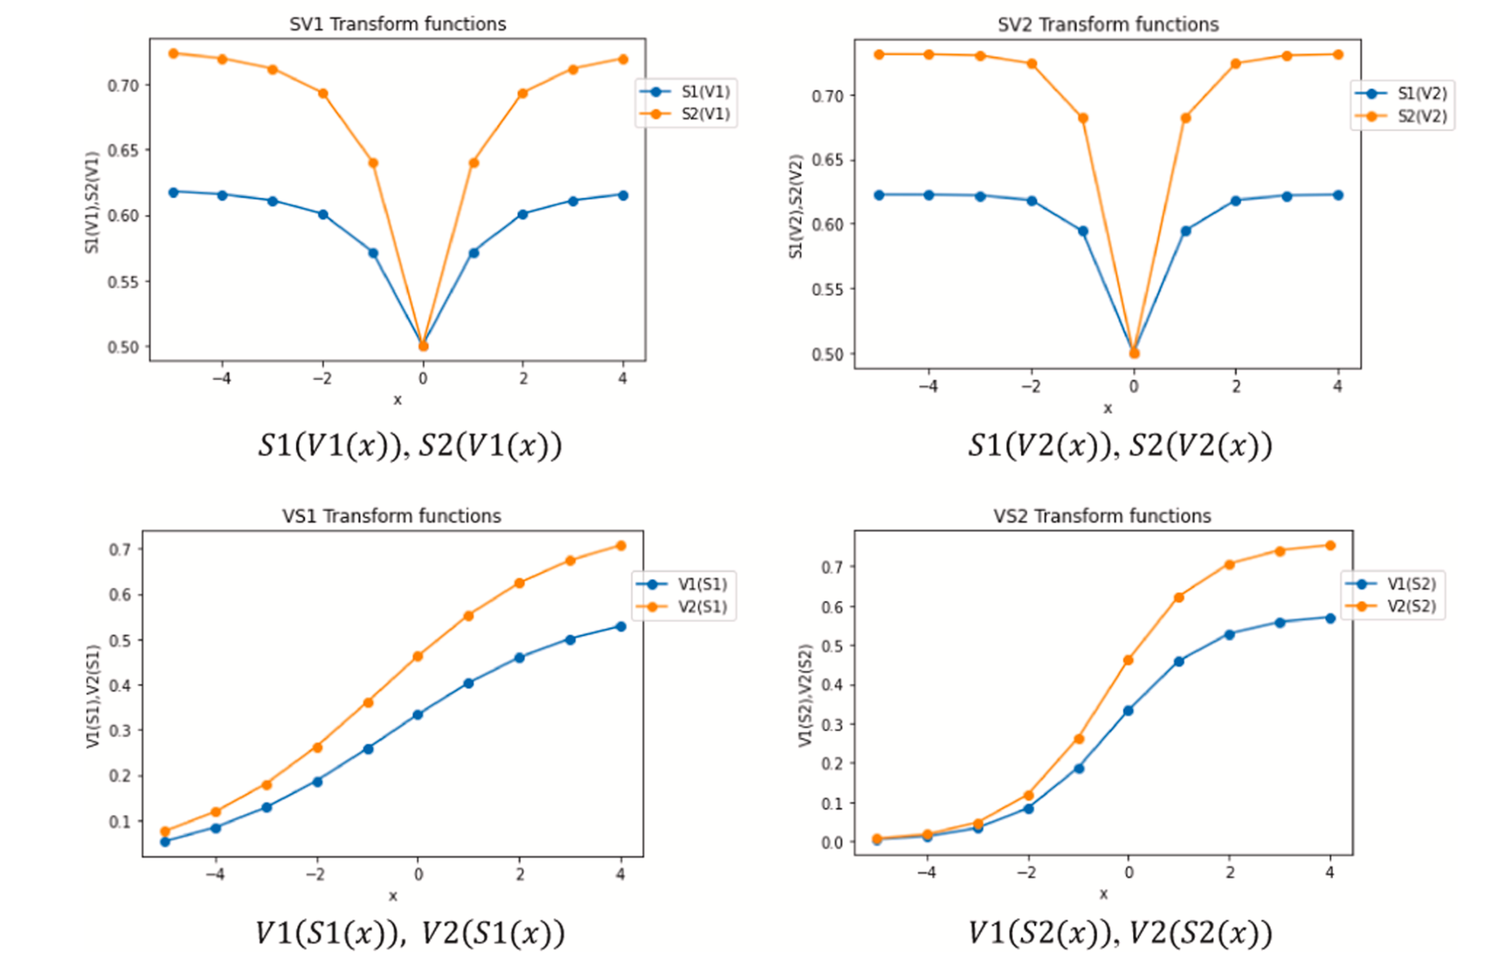
METHODOLOGY
Hybridization Strategy – HBEOSA-PSO & HBEOSA-DMO with NT
Although HBEOSA-PSO and HBEOSA-DMO Performs very well further changes are made to the algorithm to generate more variants which involves the replacement of s1,v1,s2,v2 fuctions with nested the following Nested Transform function

Slide 7
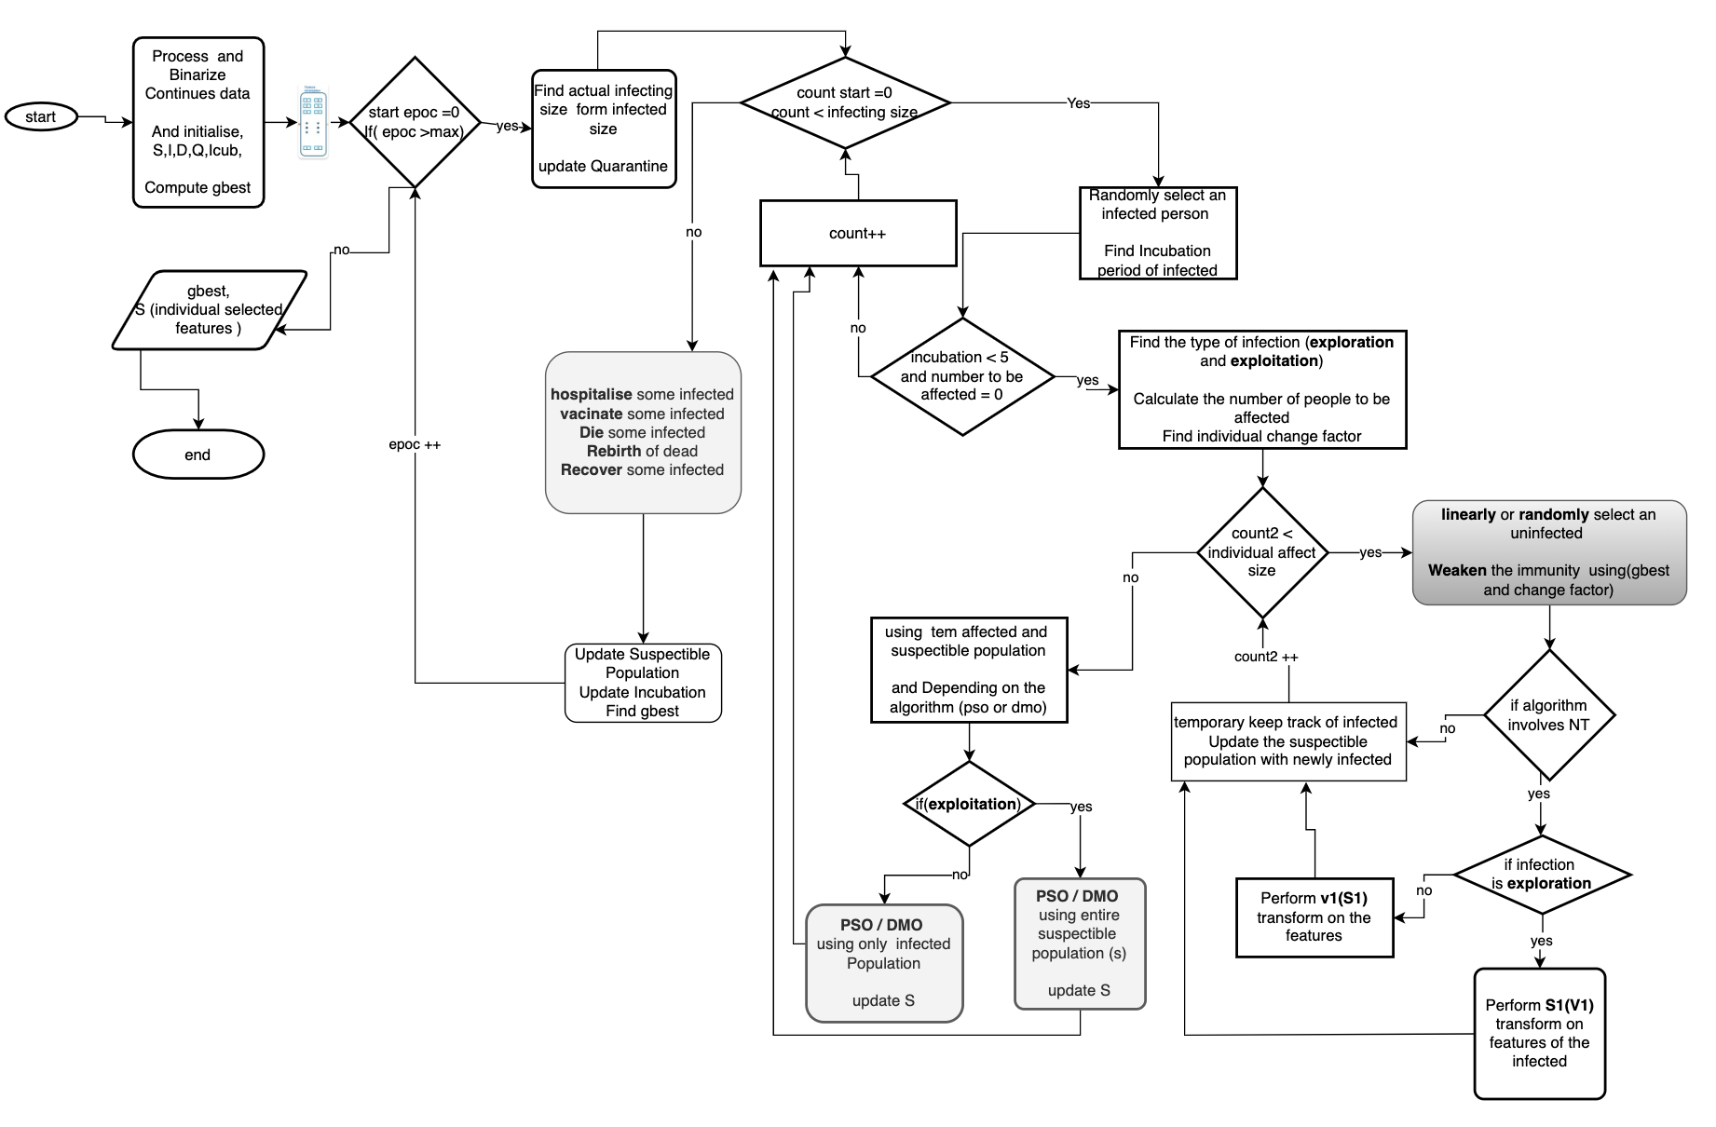
METHODOLOGY
HYBRIDIZATION PROCESS FlOW CHART

Slide 8
